Slide 1

GPT-4o mini API course for beginners
By Frank Fu

Slide 2
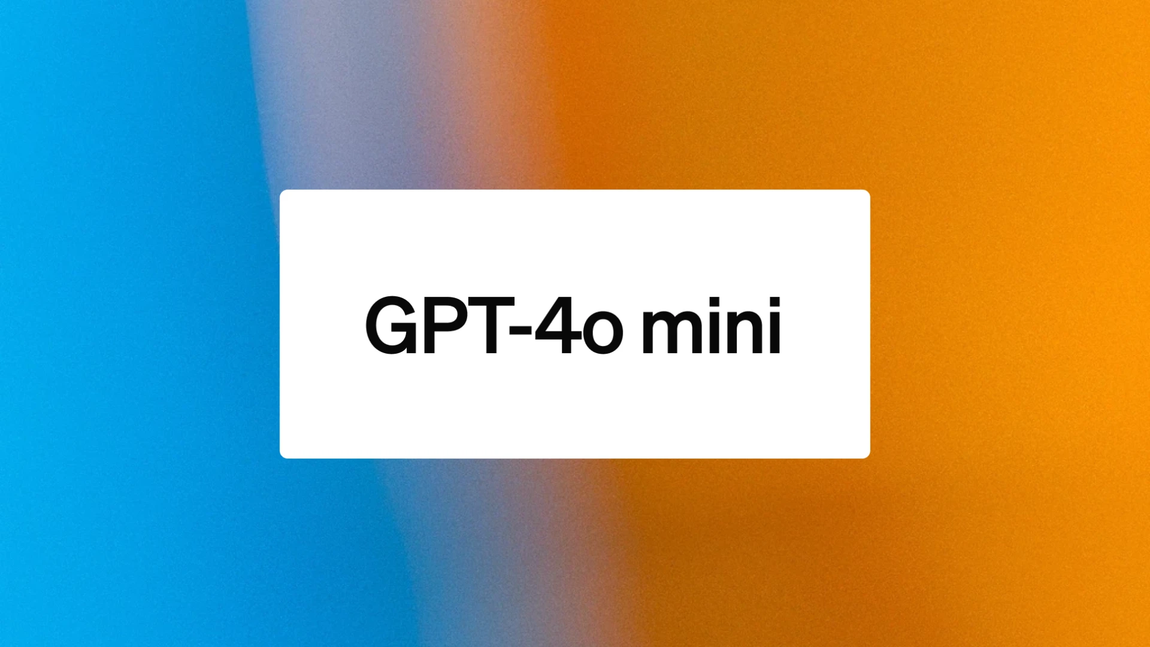
What is GPT-4o mini?
smaller, faster, and more cost-effective version of GPT-4o
Notes:
Todo：
【ppt美化】
给text、audio、vision配图，并且给出列子，参考：https://www.datacamp.com/tutorial/gpt4o-api-openai-tutorial

Slide 3
Cost-Effectiveness
Over 60% cheaper than GPT-3.5 Turbo, with pricing at just 15 cents per million input tokens and 60 cents per million output tokens.
Multimodal Capabilities
Supports text and vision inputs, with plans to expand to audio and video. Versatile for text generation and image analysis.
A Powerful Small Model
surpasses GPT-3.5 Turbo
Multilingual Understanding
supports the same range of languages as GPT-4o

Slide 4
Comparison of GPT 3.5, GPT-4o and GPT 4o-mini
 | GPT 3.5 Turbo | GPT-4o | GPT-4o mini
Price | $0.50 / 1M input $1.50 / 1M output | $5.00 / 1M input $15.00 / 1M output | $0.150 / 1M input $0.600 / 1M output
Speed |  |  | The most fast
Multimodal | Only text | Text, image, audio (later) | Text, image, audio (later)
Multilingual | Better for English | The same

Slide 5
Code
Quick start
Time compare
Image as input

Slide 6
Reference:
[1] https://openai.com/index/gpt-4o-mini-advancing-cost-efficient-intelligence/

